Slide 1
Animal Bites Project 1
Collaborators:
Antonia Anderson
Dany Koudede
Maria Martinez
Aaron Soto

Slide 2

Motivation & Summary
Goal or hypothesis of this project:
Ultimate goal is to analyze animal bites data reported over a period of time to determine if the environment an animal is in, has any influence on their behavior. We will analyze and compare factors such as local crime and weather in the Louisville, Kentucky area for our study.
Notes:
Maria

Slide 3
Motivation & Summary Slide
Describe the questions you asked:
Which zip code has the most bites?
What animal types has the most bites?
What type of breed has the most bites?
What is the gender distribution?
Is there a trend between all these?
Is there a correlation between weather and number of bites
Is there a correlation between overall crime and number of bites
Notes:
Maria

Slide 4

Motivation & Summary Slide
Describe whether you were able to answer these questions to your satisfaction, and briefly summarize your findings
Ultimately yes, some answers to these questions were more surprising than others.
From our research and analysis, we found:
Zip Code 40291 has the most bites in Louisville, Kentucky
Dogs are the cause for 81.3% of animal bites recorded
The dog breed with the most bites is the Pit Bull
Males bite twice as much than Females from the recorded info
correlation between weather and bites? yes, but not significant
correlation between crime and bites? yes, but not significant
Notes:
Maria

Slide 5

Questions & Data
Why did we ask these questions:
This information may be used to help establish local protocols that could possibly help the city and local officials reduce the number of animal bites reports if we do find a trend.
Who would benefit from this research:
The city, local veterinarians, landlords, attorneys, insurance companies and the police could use this data to help restrict certain breeds that have the most reported bites based on zip code.
Notes:
Maria

Slide 6
Questions & Data
Data needed and where we found it:
We were able to satisfactorily answer these questions from animal bite incidents reported to and investigated by Louisville Metro Department of Public Health and Wellness and made available on Kaggle.com
Crime report data provided by Louisville Metro Open Data for Louisville Metro Police Divisions
Louisville, Kentucky weather provided by OpenWeather.com
Notes:
Aaron

Slide 7

Data Cleanup & Exploration
Describe the exploration and cleanup process:
The initial thought process was to look at the available information from each dataset we were working with and determine ways to compare them within the same time period.
We used all the methods mentioned in class as well as importing the large datasets such as csv and Google API for gmaps.
Notes:
Aaron

Slide 8
Data Cleanup & Exploration
Discuss insights you had while exploring the data that you didn't anticipate:
Cost for obtaining historical weather data was not anticipated and we decided to go with weather for the city in general over time, as opposed for each zip code
Data from the animal bites incidents report was not of same quality over time; for example, the report included data going back to 1985; however tit wasn’t until about 2010 thru 2018 that quality improved. We decided to narrow our research to the years with the most available information 2013-2017.
Notes:
Aaron

Slide 9
Data Cleanup & Exploration
Discuss any problems that arose after exploring the data, and how you resolved them:
Some of the problems we encountered after exploring the data were:
extremely large amount of data
float, string, integer errors
extracting dates
finding the right weather API to use (cost efficient)
none of the data contained coordinates - this was crucial for Gmaps
Notes:
Aaron
we were able to fix these mostly by slicing especially for the years 400,000 of data especially charges
cost to gather large amounts of data

Slide 10
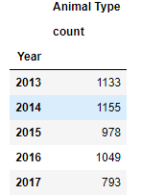
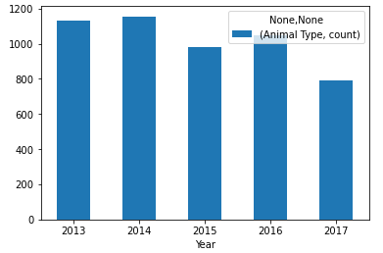
Data Analysis
Notes:
Aaron

Slide 11
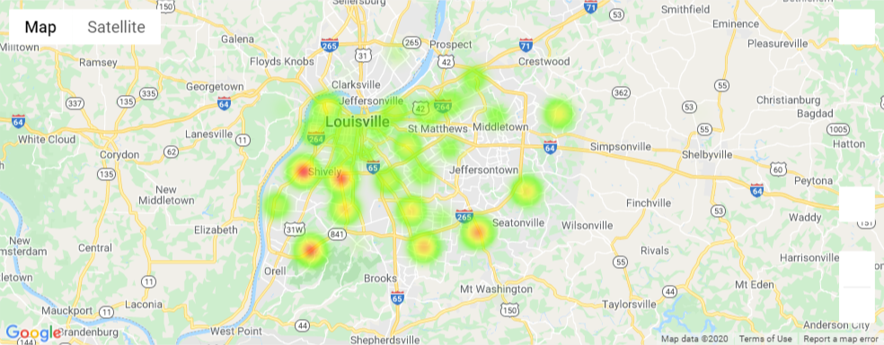
Data Analysis
Animal bites heat map for 2014
Notes:
Aaron

Slide 12
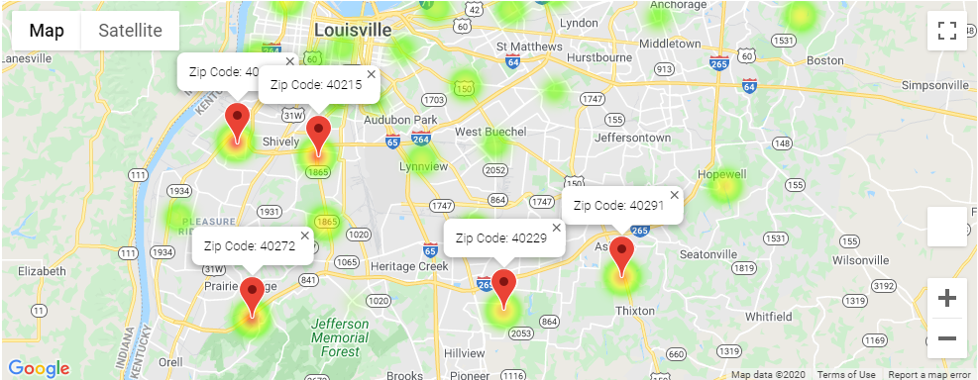
Data Analysis
Animal bites heat map for 2014 - Top 5 zip codes

Slide 13
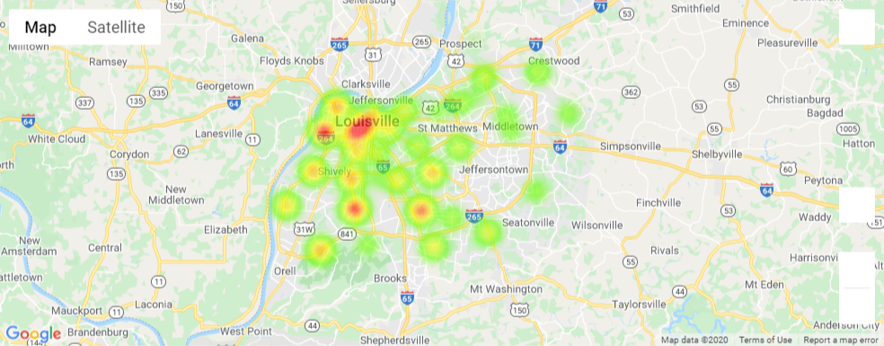
Data Analysis
Crime data heat map for 2014

Slide 14
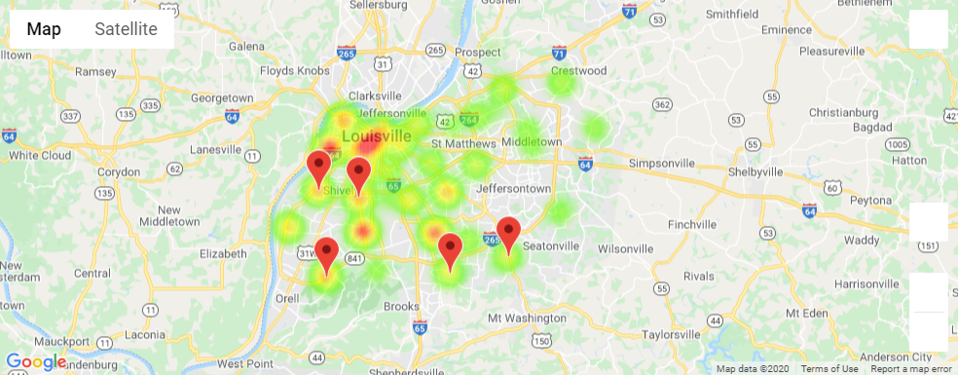
Data Analysis
Crime data heat map for 2014 - top 5 zip codes - same zip codes as bites

Slide 15
Data Analysis
Discuss the steps you took to analyze the data and answer each question you asked in your proposal
Divide datasets into their applicable data frames
Use a variety of graphs to visualize the data.
Summary on what the graphs reflect, and whether we reject the null hypothesis or not
Notes:
Antonia

Slide 16
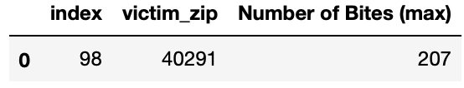
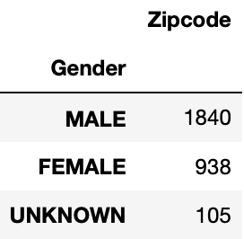
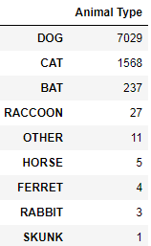
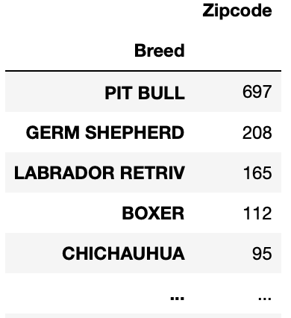
Data Analysis
Which zip code has the most bites? What is the gender distribution?
What type of breed has the most bites? What animal types has the most bites?
Notes:
most bites by zip code -it is for 2013-2017 period
based on the analysis 2014 is the year with most bites overall
Antonia

Slide 17
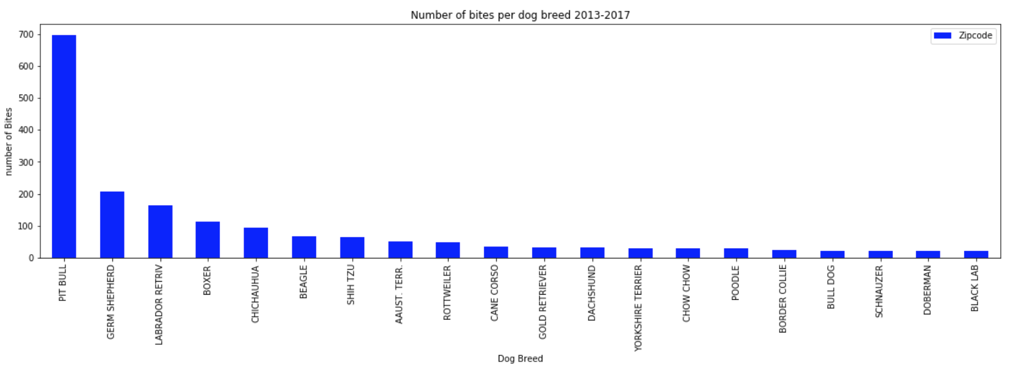
Data Analysis
Present and discuss interesting figures developed during analysis, ideally with the help of Jupyter Notebook
Notes:
Antonia

Slide 18
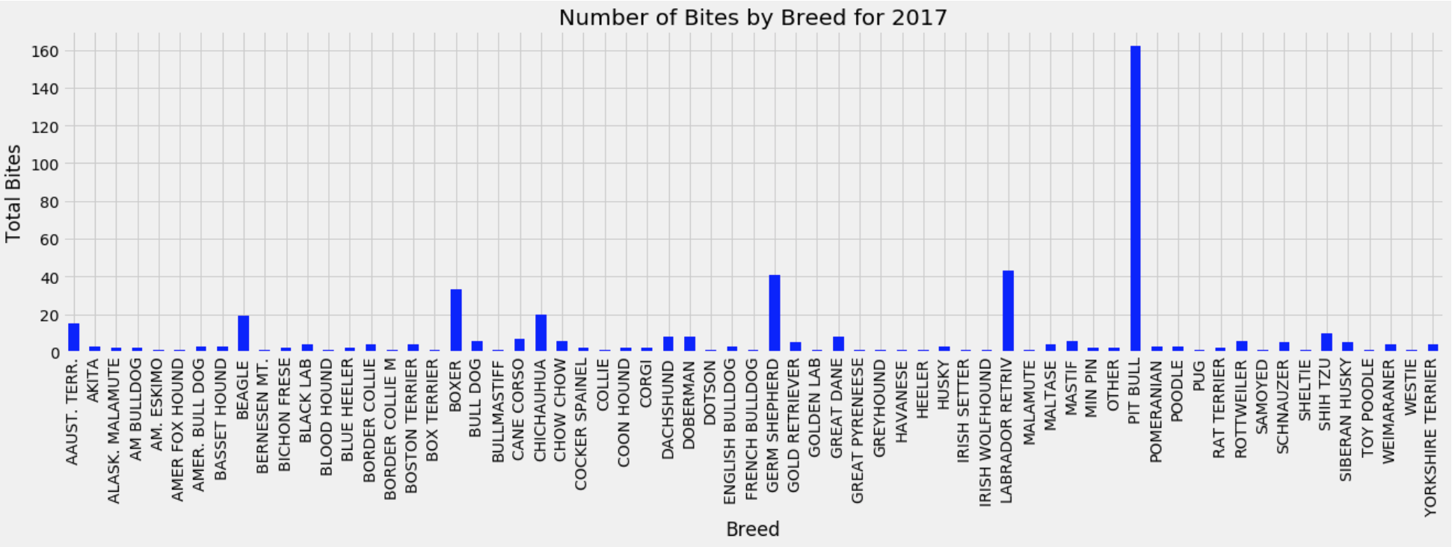
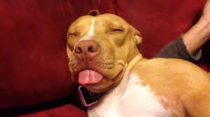

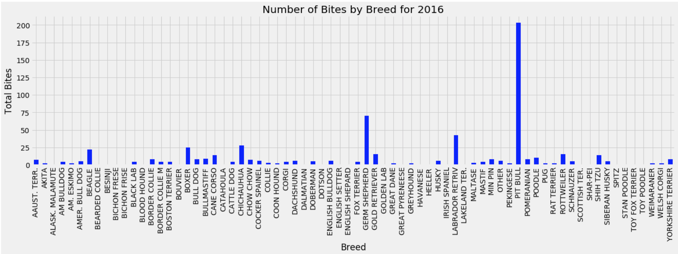
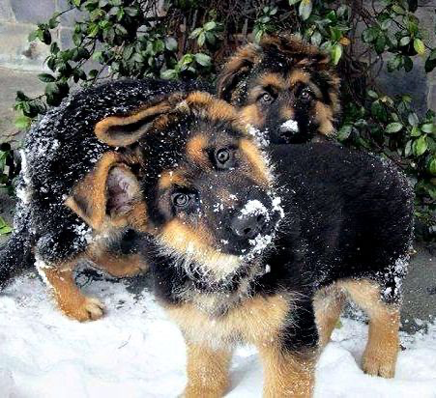
Data Analysis
Notes:
Antonia

Slide 19
Discussion
Discuss your findings. Did you find what you expected to find? If not, why not? What inferences or general conclusions can you draw from your analysis?
Overall, our findings suggest that animal bites tend to occur with increased frequency due to the effects of external factors such as weather and aggressive or violent environments; however it appears, Pit Bulls are prone to aggressiveness simply by their nature.
Notes:
Dany

Slide 20
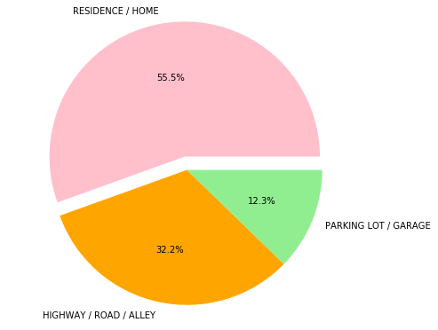
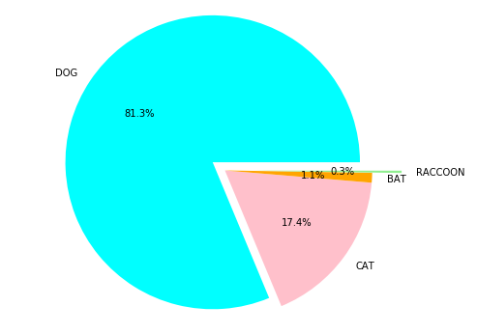
Data Analysis
Notes:
Dany

Slide 21
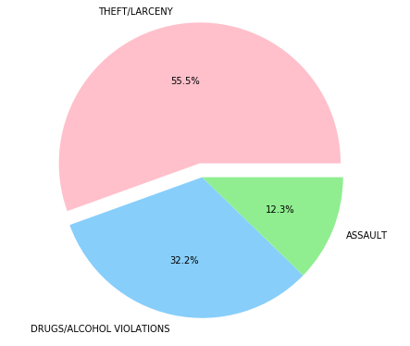
Data Analysis
Notes:
Dany

Slide 22
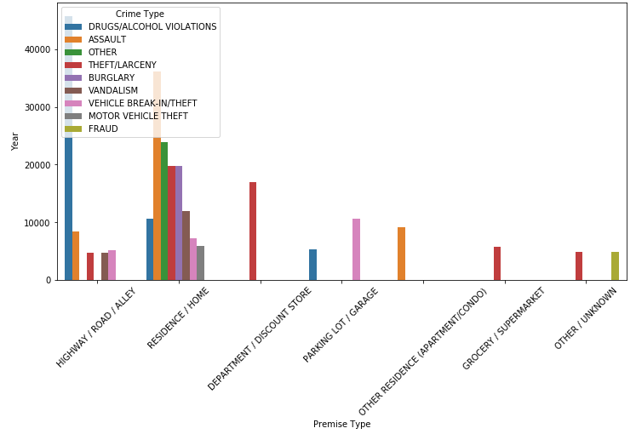
Data Analysis
Notes:
Dany

Slide 23
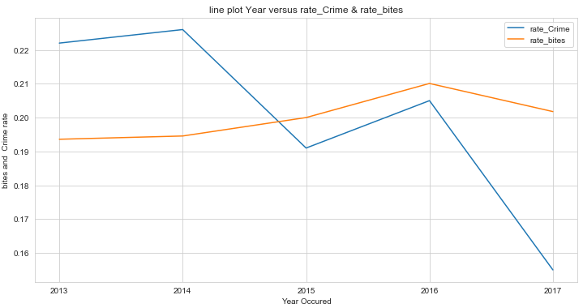
Data Analysis
Notes:
Dany

Slide 24
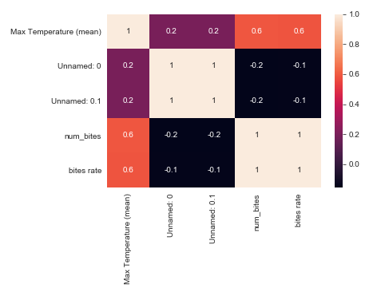
Data Analysis
Notes:
Dany

Slide 25
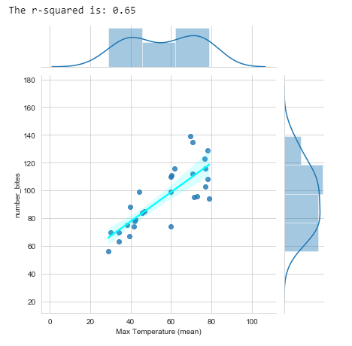
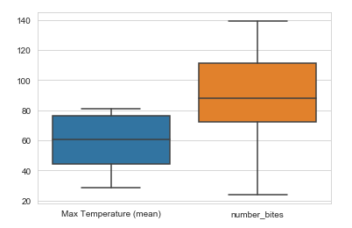
Data Analysis
Notes:
Dany

Slide 26
Post Mortem
Discuss any additional questions that came up, but which you didn't have time to answer:
Based on nulls, does documentation quality increase based on 30 yrs of data?
What would you research next, if you had two more weeks?
Other environmental factors that could possibly influence on the number of bites (or crime) in the 5 year time range
Where is the bite more dangerous (i.e leg, arm, etc)?
Which animal bite is most dangerous?
How does the animal bite information in Louisville, KY compare to that across the United States?
Analyzing recent data (2018 +)
Notes:
Dany

Slide 27

Questions?

